Slide 1

Institute of Technology of Cambodia
Data structure and programming
Lecturer : 1. Dr Chan sophal (TP)
2. Dr Bou channa (cours)
Topic : Quadratic probing

Slide 2
Group members
Heang LeabHeng
Keo Vonmonyroth
Chhon Chaina
Dorn Dawin
Mengheab Vathnak
Koythol Amrint
Meach Seaklav

Slide 3
Table of contents
Hash collision
What is Quadratic probing
Why do we use Quadratic probing
How Quadratic Probing is done
Quadratic probing implementation

Slide 4
Hash Collision
Hash Collision is a situation when two or more data hash to be stored in the same location in the table.
Collision Resolution Techniques
Separate Chaining (Open Hashing)
Open Addressing (Closed Hashing)
Linear probing
Quadratic probing
Double hashing

Slide 5
What is Quadratic probing ?
Quadratic probing is an open addressing scheme in computer programming for resolving hash collision in the hash table.
Quadratic probing can be a efficient algorithm in a open addressing table, since it better avoids the clustering problem that can occur with linear probing , although it’s not immune-
What is the main problem of quadratic probing?
There is one problem with quadratic probing: Its probe sequence typically will not visit all slots in the hash table . Unfortunately, quadratic probing has the disadvantage that typically not all hash table slots will be on the probe sequence.

Slide 6
Why do we use quadratic probing?
Assuming we need some collision resolution algorithm, Quadratic probing can be a more efficient algorithm in a closed hash table, since it better avoids the clustering problem that can occur with linear probing, although it is not immune .

Slide 7
Advantage and disadvantage of using quadratic probing.
Advantage: The problem of primary clustering is eliminated
Disadvantage: There is no guarantee of finding an unoccupied cell once the table is nearly half full.

Slide 8
An Efficient Way of Doing Quadratic Resolution •
h(x) = (hash(x) + f(i)) mod Table. Size , f(i) = i ^2
In the (i-1) probe, we need to compute f(i-1) = (i-1)^2, and in the (i-th) probe, we need to compute f(i-th) = (i-th)^ 2.
Is there a more efficient way to compute f(i) from f(i-1)?
f(i) - f(i-1) = i ^2 - (i-1)^2 = i^ 2 – (i ^2 - 2*i +1) = 2*i -1
Thus, we have
f(i) = f(i-1) + 2*i - 1
f(i-1) : in the previous probe, we have computed it.
2*i : one bit right shift of i.

Slide 9
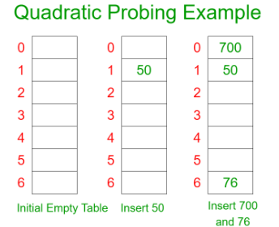
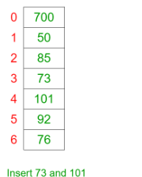
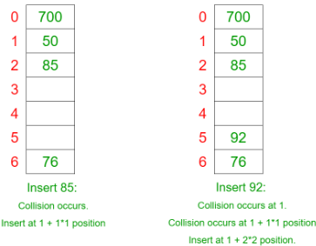
.For Example
. Let us consider a simple hash function as “key mod 7” and sequence of keys as 50, 700, 76, 85, 92, 73, 101.

Slide 10
How Quadratic Probing is done?
. Let hash(x) be the slot index computed using the hash function.
If the slot hash(x) % S is full, then we try (hash(x) + 1*1) % S.
If (hash(x) + 1*1) % S is also full, then we try (hash(x) + 2*2) % S.
If (hash(x) + 2*2) % S is also full, then we try (hash(x) + 3*3) % S.
This process is repeated for all the values of i until an empty slot is found.

Slide 11
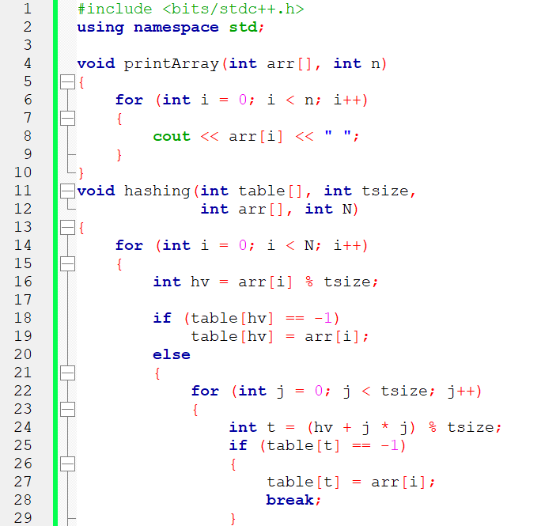
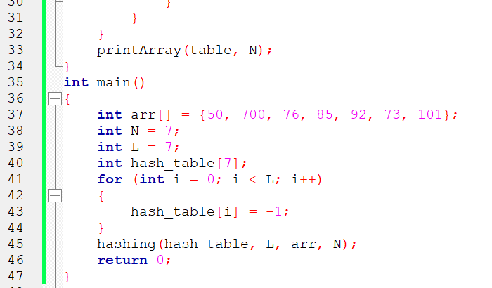
Hash implementation using Quadratic probing
Time Complexity: O(N * L), where N is the length of the array and L is the size of the hash table.

Slide 12
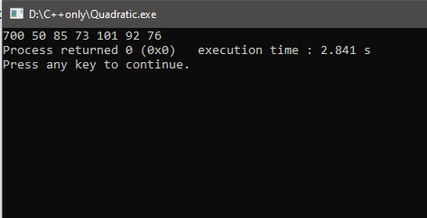
OUTPUT

Slide 13

THANKS!
Any questions?

